Slide 1
Final Project
Hunter Bruso
Isaiah Tadrous

Slide 2
Project idea
In this project, we took the Netflix database, and wanted to analyze the rating description to the user rating score. We are interested in this analysis because we wanted see how user ratings stand up to the rating description. We believe that user ratings are more important than rating descriptions and want to see how they are affected.

Slide 3
Before we begin
Research question: how similar are the ratings that are given to the rating description compared to the user rating
How we organized our data: Used different ranks to separate my data values then separated them into graphs based on the rank and year they were made
100 or above S
95-99 A
89-94 B
76-88 C
65-75 D
64 or below is an F

Slide 4
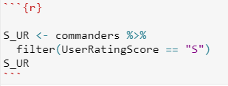

Our Code
We used this code using the filter command to separate each data section into its own ranking
we then used these separations to create a bar graph for each rank of data set

Slide 5
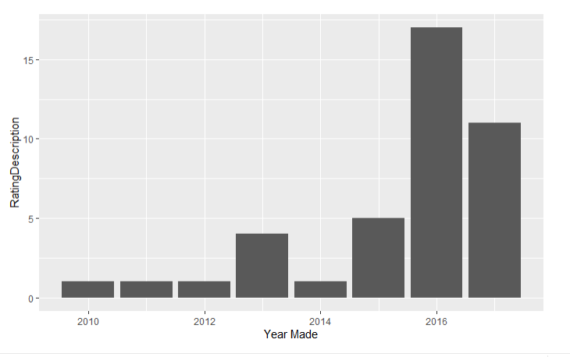
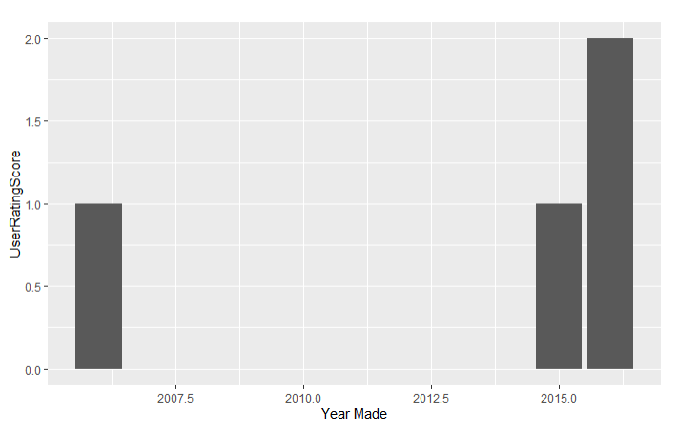
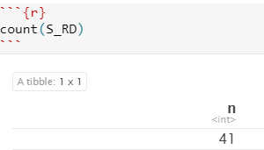
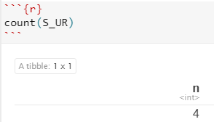
S_Rank
A lot of data in RD 41 to 4
Lowest amount of data points from UR

Slide 6
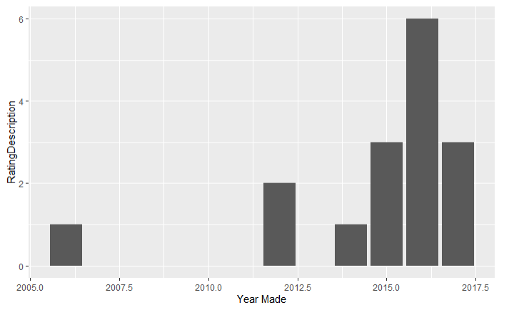
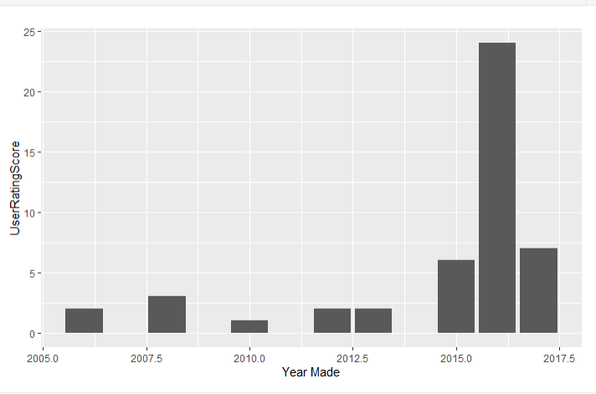
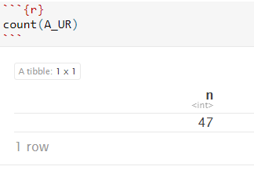
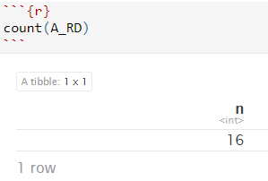
A_Rank
highest data value for UR

Slide 7
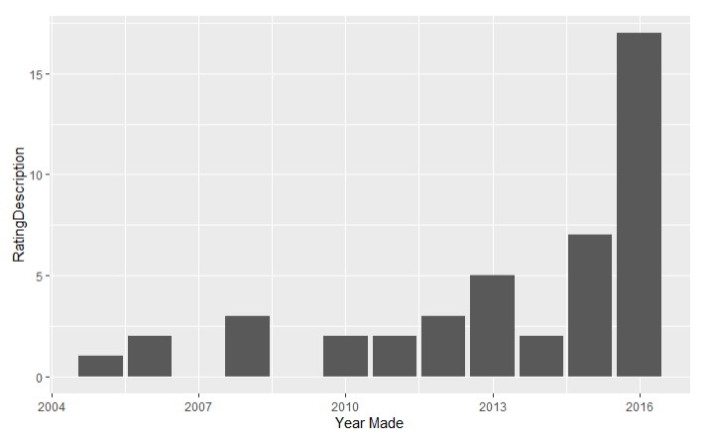
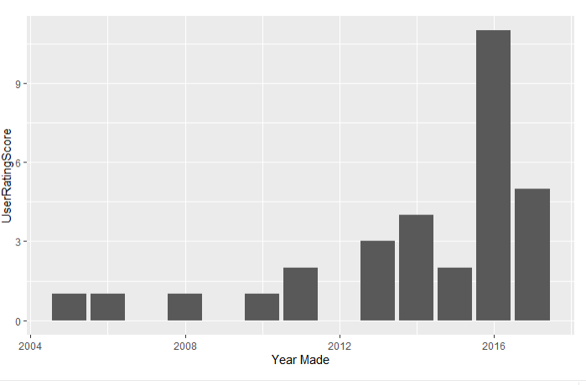
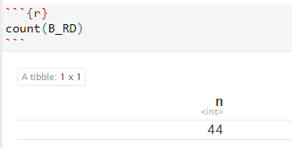
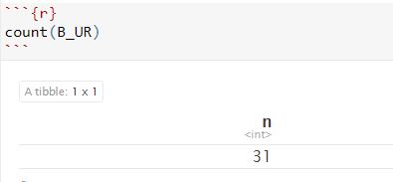
B_Rank
Closest in count

Slide 8
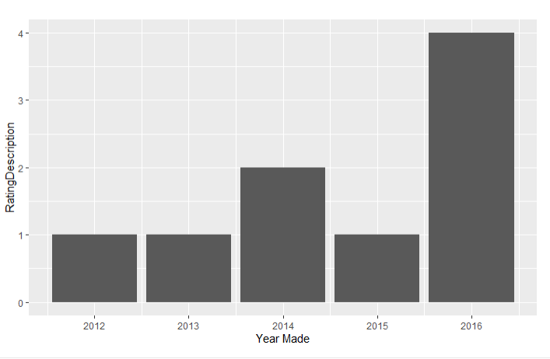
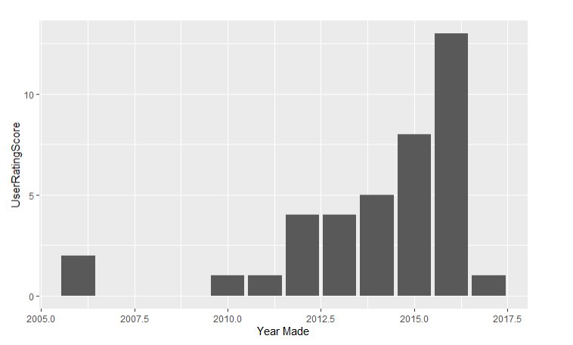
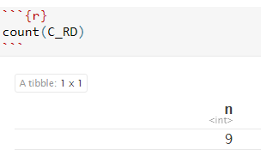
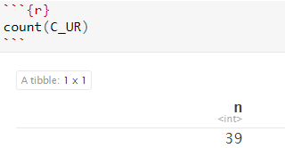
C_Rank
Lowest RD data
Most diverse data

Slide 9
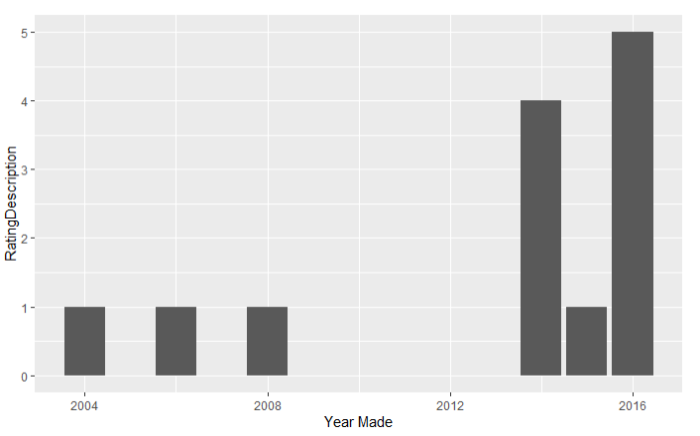
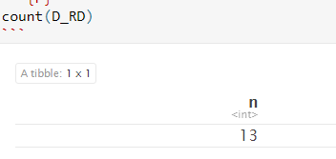
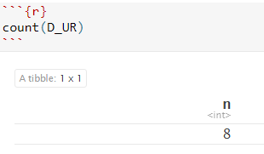
D_Rank
Most similar Graph data from both
bar graphs

Slide 10
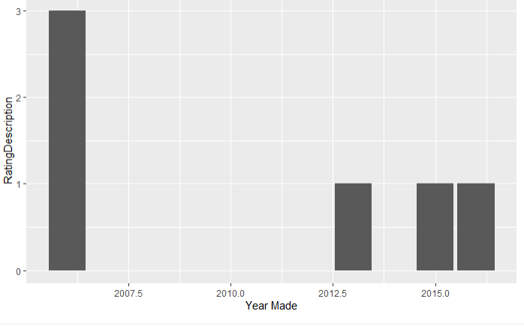
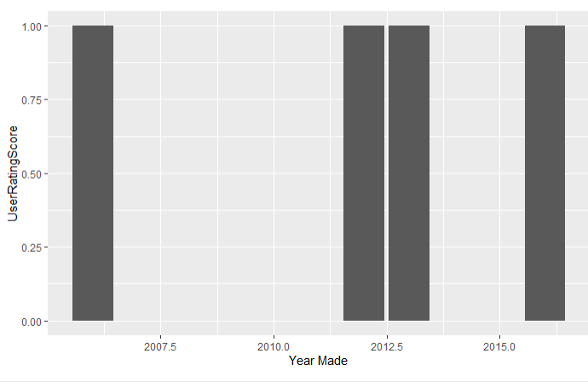
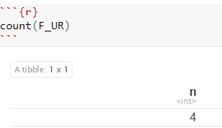
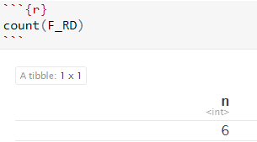
F_Rank
Lowest data value for both UR and RD

Slide 11
Conclusion
What I learned in about my data:
Lowest value set was in F_Rank where the total was 10
The most similar data table was B_Rank
The most diverse data table was found in C_Rank
Are the ranking in movies similar for ranking description compared to the user rating: no
What skills I used in R: creating bar graphs, separating data R from a graph into separate exponents, finding the counts of graphs in r studio

